Slide 1
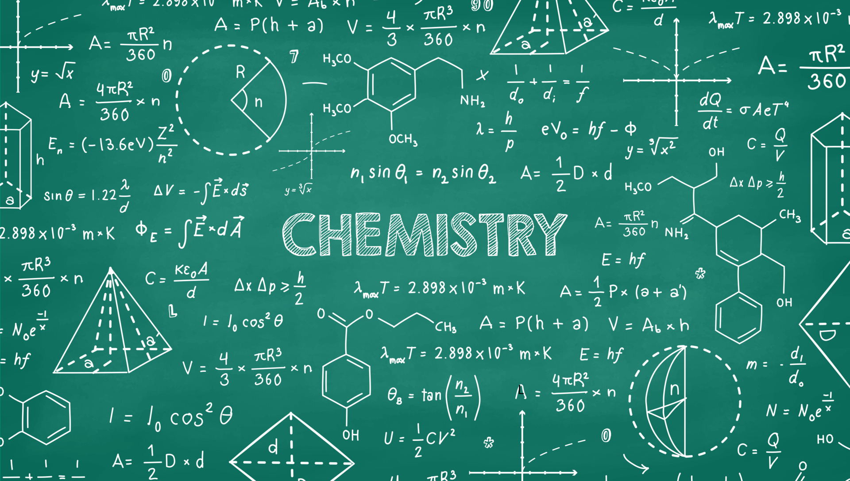


بسم الله الرحمن الرحيم
Title: Measuring Matter: The Mole Unit
Chemistry | Grade 10 ADV

Slide 2
Learning Objectives
Define the mole as the SI unit for amount of substance.
Relate Avogadro’s number to counting particles (atoms, molecules).
Convert between moles and number of particles.

Slide 3


Everyday Counting Units
Dozen 12
Pair 2
Gross 144
Quick poll via Mentimeter
Notes:
https://www.mentimeter.com/app/presentation/al8ba5ygvwkbc29zsubp4bk3pfs84tdt/edit?question=nwxwxqqj4rq8

Slide 4
Why We Need the Mole
Question: “Could you count out atoms one by one to make water?
2 H atoms + 1 O atom
How Big is a Mole

Slide 5
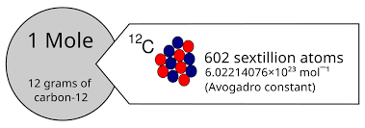
Introducing Avogadro’s Number
6.02 × 10²³
If you had a mole of basketballs, they’d cover the Earth!
A mole of seconds is longer than the age of the universe.

Slide 6
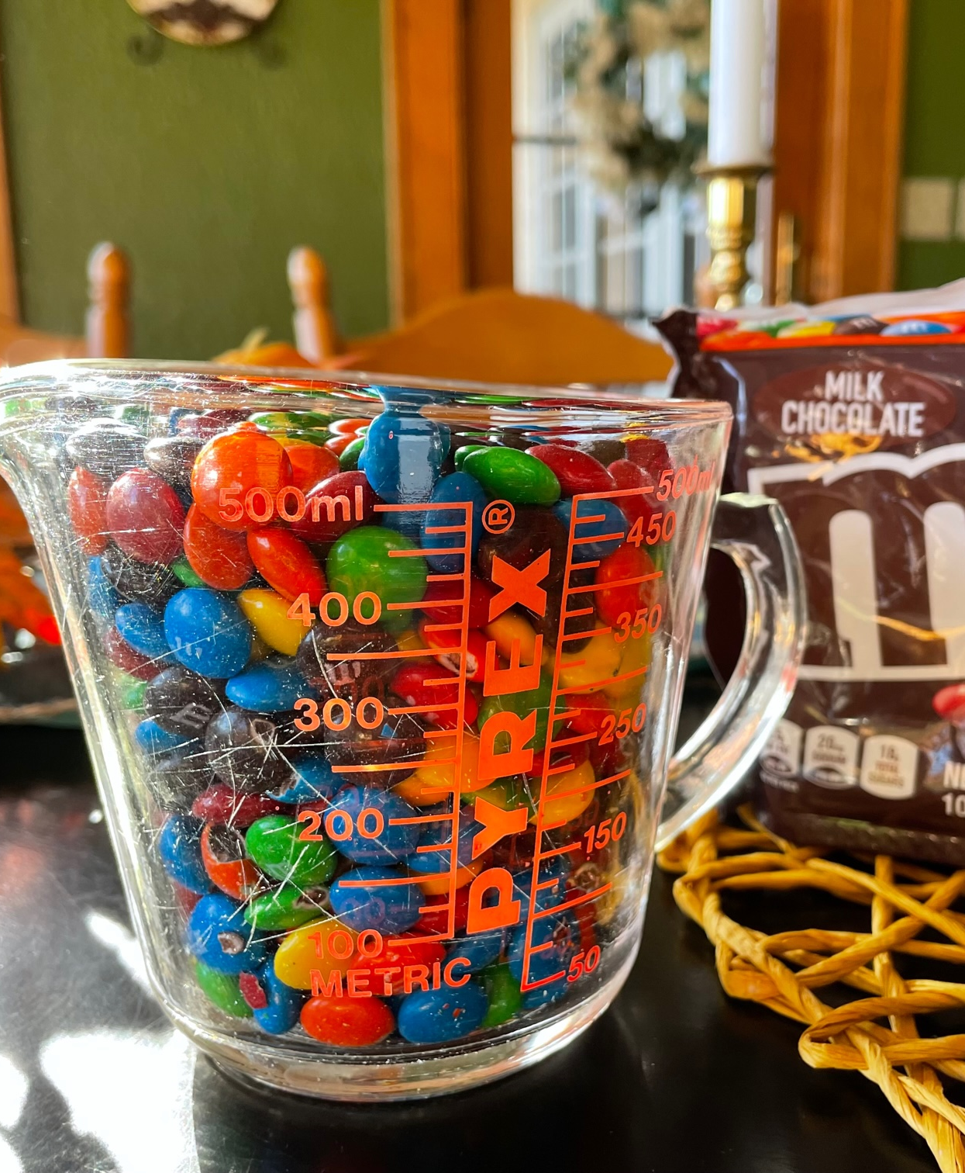

Explore: Mass vs. Particle Count
Weigh “bundles” of different particles (M&Ms vs. skittles)
Same 12 of items, different masses — just like atoms!

Slide 7
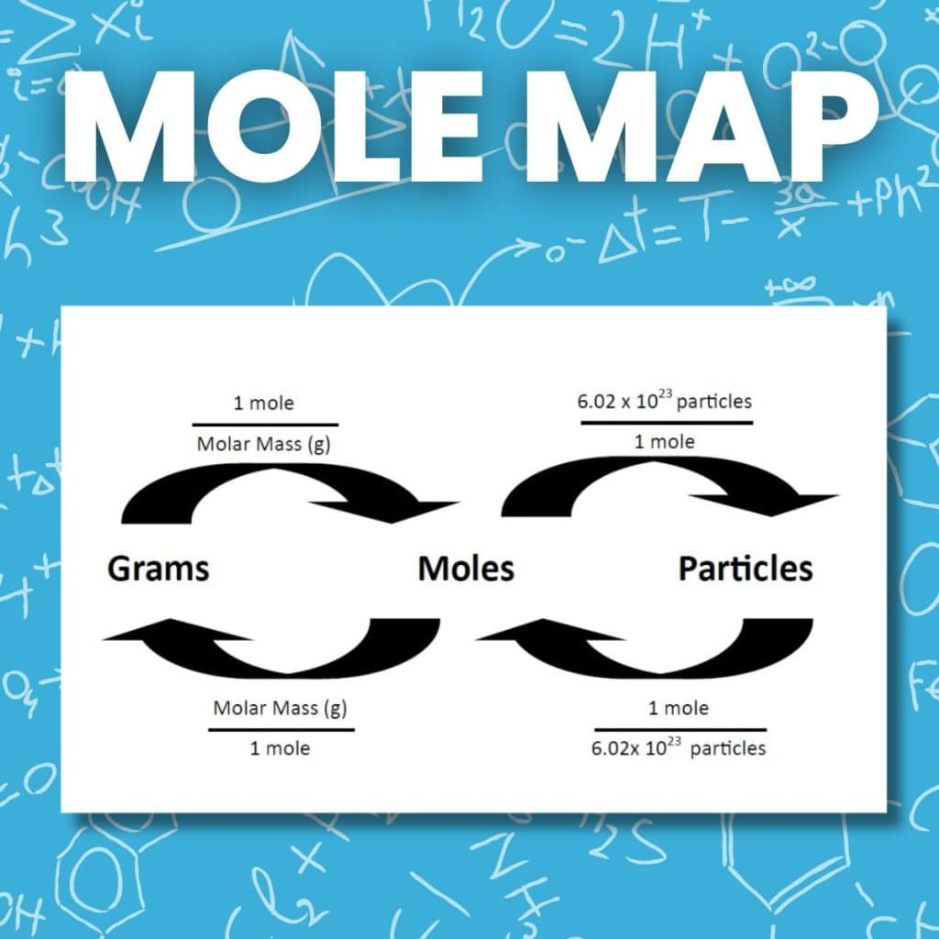
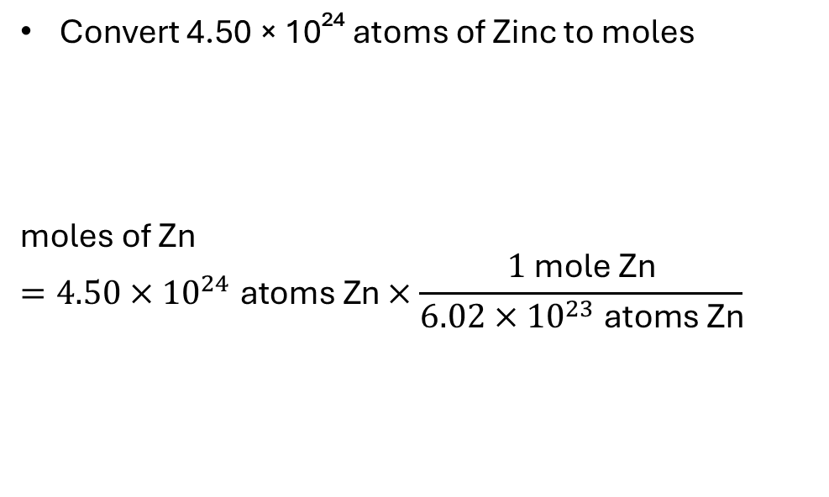
Conversion Formula & Example
Convert 4.50 × 10²⁴ atoms of Zinc to moles
$$\text{moles} \text{of} \text{Zn}=4.50×{10}^{24} \text{atoms} \text{Zn}×\frac{1 \text{mole} \text{Zn}}{6.02×{10}^{23} \text{atoms} \text{Zn}}$$

Slide 8

Quick Practice
How many atoms in 2.5 moles of Carbon?

Slide 9
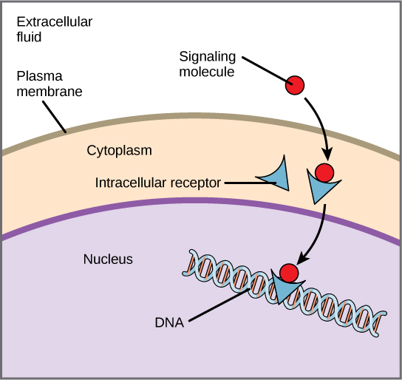
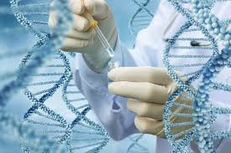
Real-World Connection
Why do pharmaceutical companies in the UAE use moles instead of grams for medicines?
Precision saves lives. Moles ensure each molecule interacts correctly in your body.
Moles ensure exact molecule counts for cellular receptors.

Slide 10
Summary & Close
Mole = counting unit for chemistry.
Avogadro’s number = 6.02 × 10²³ particles/mole.
Use conversions to switch between moles and particles.
Final Task: worksheet submission (Homework)

