Slide 1
Reactions and Equations
Chemical Reactions Unit | LO1
Today’s Big Question
How do chemists model chemical reactions?
Class Activity
Observe baking soda reacting with vinegar.
Main Skill
Write and balance simple equations.
Be ready to observe, discuss, write, and check your equations.
1
Notes:
Welcome students. Explain that this lesson is interactive: observe, identify evidence, write equations, and balance equations.

Slide 2
Learning Outcomes
By the end of this lesson, I can:
Identify reactants, products, and evidence of a chemical reaction.
Write a word equation and a skeleton equation for a simple reaction.
Balance a simple chemical equation using coefficients.
Check that atoms are conserved on both sides of an equation.
Success looks like this:
I use correct scientific words, keep formulas unchanged, change coefficients only, and check atom counts.
2
Notes:
Read outcomes with students and clarify key terms.

Slide 3
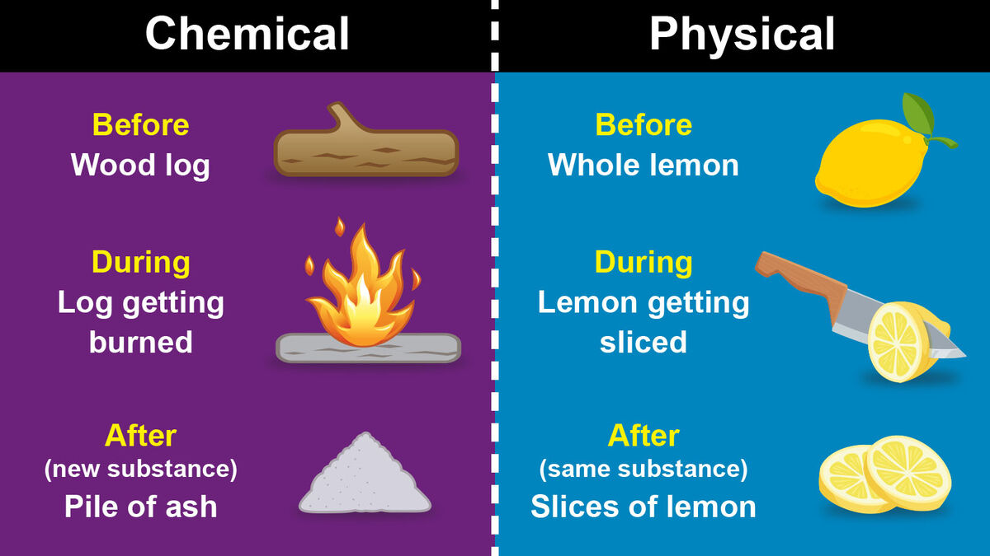
Warm-Up: Is It a Chemical Reaction?
Think individually, then discuss with a partner.
Example A
Ice melts into water.
Chemical reaction or physical change?
Example B
Bread turns brown in a toaster.
Chemical reaction or physical change?
Example C
A tablet fizzes in water.
Chemical reaction or physical change?
Discuss: What evidence helped you decide?
3
Notes:
Starter. Ice melting is physical; browning toast and fizzing tablet suggest chemical change. FeaturePhysical ChangeChemical ChangeCompositionRemains exactly the same.Changes entirely into a new substance.ReversibilityUsually easily reversible.Usually permanent and irreversible.Energy ChangeLittle to no energy absorbed or released.Energy is usually absorbed or released (heat, light, sound).ExamplesMelting ice, chopping wood, boiling water, dissolving sugar.Burning wood, rusting iron, baking a cake, digesting food.

Slide 4
What Is a Chemical Reaction?
A chemical reaction happens when atoms are rearranged to form new substances.
Reactants
Starting substances
(before reaction)
Products
New substances formed
(after reaction)
Evidence
Observable signs that a reaction happened
Reactants → Products
4
Notes:
Define chemical reaction using simple language.

Slide 5
Evidence of Chemical Reactions
Look for observable changes.
Gas bubbles
A gas is produced.
Colour change
New substance may form.
Temperature change
Energy may be released or absorbed.
Odour
A new smell may appear.
Solid forms
A precipitate may form.
Light produced
Energy may be released as light.
5
Notes:
Use the video link if a visual demonstration is useful before the hands-on activity.

Slide 6
How Do We Write a Chemical Reaction?
reactant + reactant → product + product
+ sign
Separates substances on the same side.
→ arrow
Means “reacts to produce” or “yields”.
Sides
Left = reactants
Right = products
Quick check: Where are the reactants written?
6
Notes:
Ask students to identify the reactant and product sides.

Slide 7
State Symbols
State symbols tell us the physical state of each substance.
(s)
solid
(l)
liquid
(g)
gas
(aq)
dissolved in water
(aqueous)
Example: H₂O(l) means water in the liquid state.
7
Notes:
Briefly explain state symbols.

Slide 8
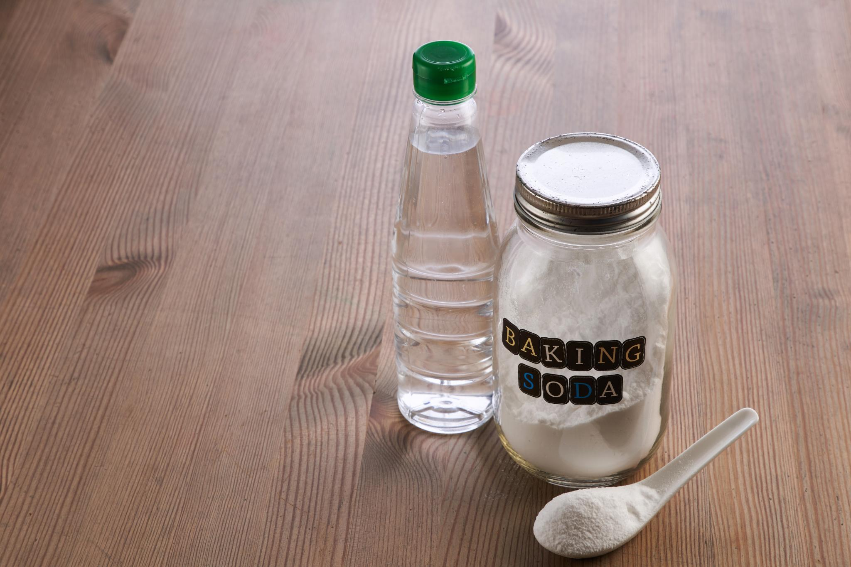
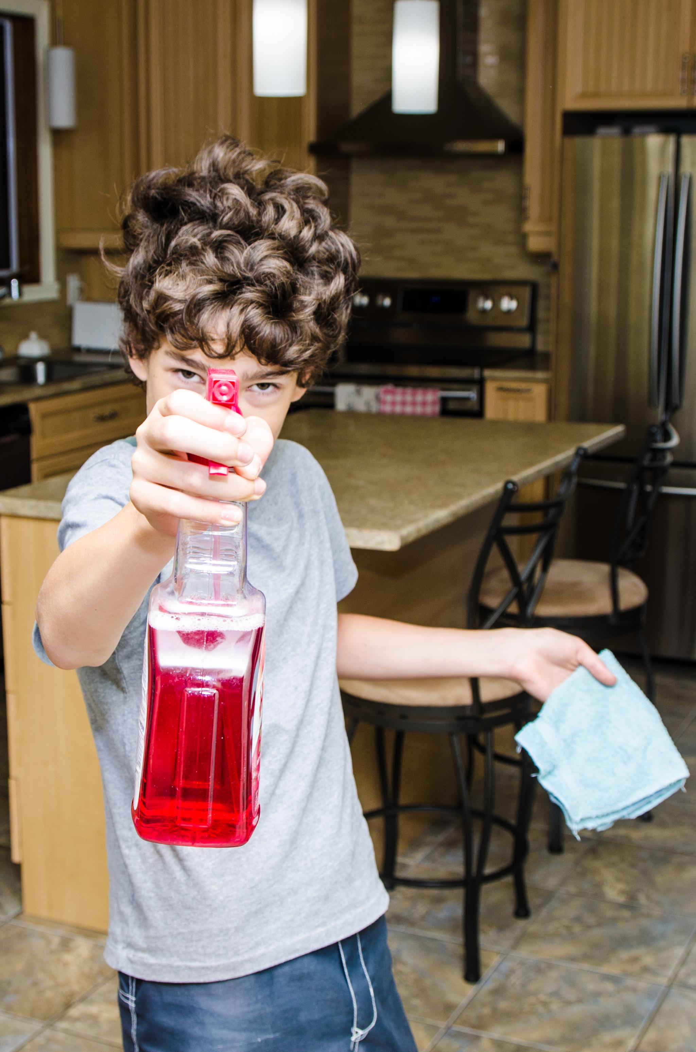
Class Experiment: Baking Soda + Vinegar
Observe carefully and record evidence.
1. Put 1 teaspoon of baking soda in a clear cup.
2. Predict: What evidence might you see?
3. Add 20–30 mL vinegar.
4. Observe for 30–60 seconds.
5. Record evidence on your worksheet.
Materials
Clear cup, baking soda, vinegar, teaspoon, paper towel, worksheet.
Safety Rules
Do not taste. Keep the cup on the desk. Clean spills. Wear goggles if available.
CO₂ bubbles
▶ Optional pre-lab video: observe the reaction
8
Notes:
Explain safety. Use link as an optional preview or backup demonstration.

Slide 9
Observation Record
Use clear, scientific observations.
Before Mixing
During Reaction
After Reaction
Use words such as bubbles, fizzing, gas, temperature, reactant, and product.
9
Notes:
Students record observations objectively.

Slide 10
Writing the Equation for Our Reaction
Word Equation
sodium bicarbonate + acetic acid → sodium acetate + water + carbon dioxide
Skeleton Equation
NaHCO₃ + CH₃COOH → NaCH₃COO + H₂O + CO₂
Reactants: NaHCO₃ and CH₃COOH
Products: NaCH₃COO, H₂O, and CO₂
CO₂ gas explains the bubbles/fizzing.
▶ Video: equations & balancing
10
Notes:
Connect the observation to the equation and identify reactants/products.

Slide 11
Word Equation vs Skeleton Equation
Word Equation
Uses names of substances.
Example:
hydrogen + oxygen → water
Skeleton Equation
Uses chemical formulas.
Example:
H₂ + O₂ → H₂O
Skeleton equations show formulas, but they may not show equal numbers of atoms yet.
11
Notes:
Explain why balancing is the next step.

Slide 12
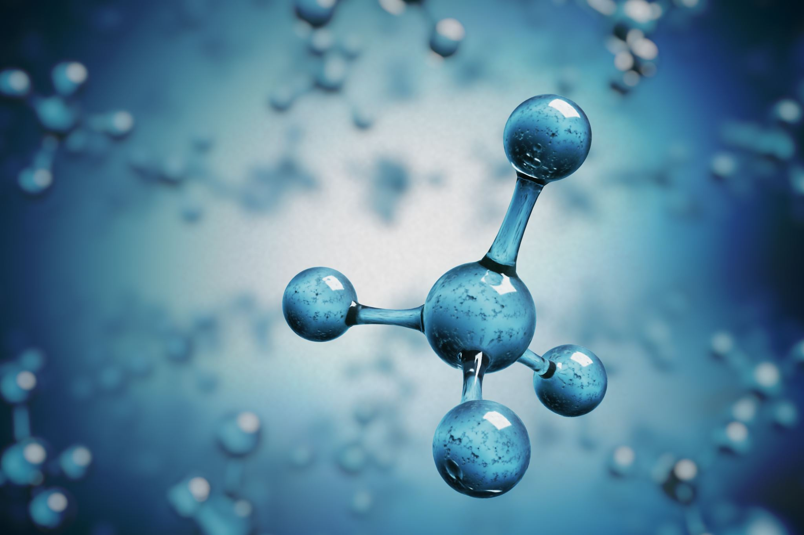
Why Must Equations Be Balanced?
Atoms are conserved: they are not created or destroyed in a chemical reaction.
Balanced equation
Same number of each atom on both sides.
How to balance
Change coefficients only. Never change subscripts.
Coefficient: 2H₂O = two water molecules | Subscript: H₂O = formula of water
12
Notes:
Stress the difference between coefficients and subscripts. Changing subscripts changes the substance.

Slide 13
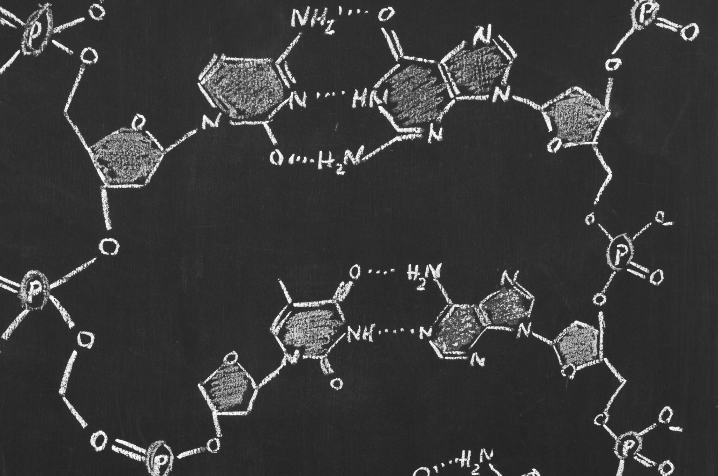
Steps for Balancing an Equation
1
Write the skeleton equation.
2
Count atoms on the left and right.
3
Add or adjust coefficients.
4
Check atom counts again.
5
Use the lowest whole-number ratio.
13
Notes:
Students copy these steps.

Slide 14
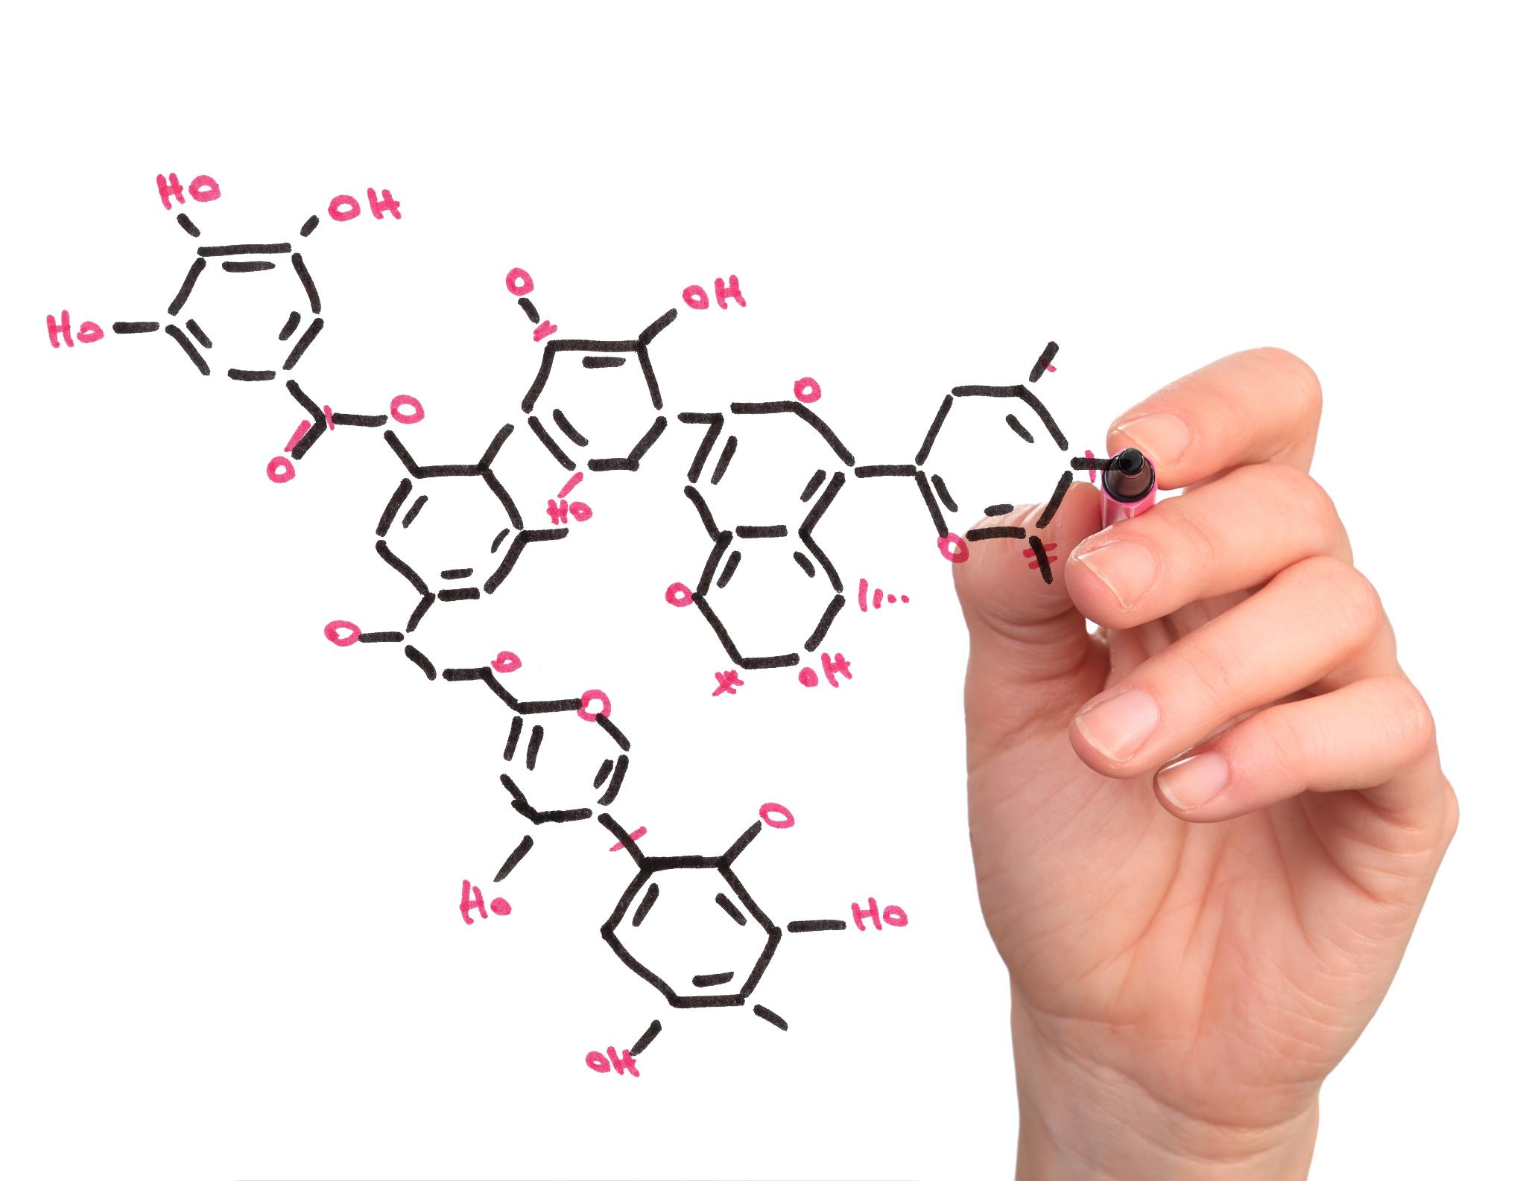
Worked Example: Balance Water Formation
Skeleton Equation
H₂ + O₂ → H₂O
Count atoms: Left = H:2, O:2 | Right = H:2, O:1
Balance oxygen: H₂ + O₂ → 2H₂O
Now hydrogen is not balanced: Left = H:2 | Right = H:4
Balance hydrogen: 2H₂ + O₂ → 2H₂O
Final check: H:4 and O:2 on both sides.
14
Notes:
Model the process slowly. Remind students not to change O₂ or H₂O subscripts.

Slide 15
Guided Practice: You Try
Balance this equation:
Mg + O₂ → MgO
Step 1
Count Mg and O atoms.
Step 2
Add coefficients.
Step 3
Check both sides.
Answer: 2Mg + O₂ → 2MgO
⚙ Try PhET simulation
15
Notes:
Give students 2 minutes before showing the answer. Ask a student to explain the atom count.

Slide 16
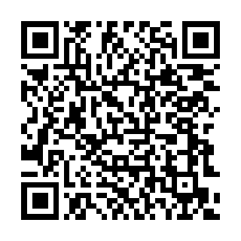
Whiteboard Check
Write your answer and hold it up.
Question 1
Identify the reactants:
NaHCO₃ + CH₃COOH → NaCH₃COO + H₂O + CO₂
Question 2
What evidence showed CO₂ gas was produced?
Question 3
Can we change H₂O to H₂O₂ to balance? Why?
Answer Check
Listen for: reactants, bubbles/fizzing, and “No—changing subscripts changes the substance.”
Scan for PhET
16
Notes:
Formative assessment slide.

Slide 17
Group Challenge
Work together and explain your reasoning.
Balance: ___Al + ___Br₂ → ___AlBr₃
1. Count atoms on both sides.
2. Add coefficients only.
3. Check that Al and Br are equal on both sides.
4. Prepare to explain your answer.
Hint
Br appears as Br₂ on the left and Br₃ in the product. Think about a common multiple of 2 and 3.
Answer
2Al + 3Br₂ → 2AlBr₃
17
Notes:
Extension challenge.

Slide 18
Common Mistakes to Avoid
Mistake 1
Changing subscripts to balance.
Wrong: H₂O → H₂O₂
Mistake 2
Forgetting to check all atoms after changing one coefficient.
Mistake 3
Using coefficients that can still be simplified.
✘ Wrong: H₂O₂ ✔ Correct: 2H₂O
Remember: coefficients change the amount; subscripts change the substance.
18
Notes:
Review common misconceptions.

Slide 19
Exit Ticket
Complete independently before leaving.
1. List two pieces of evidence from today’s reaction.
2. Identify one reactant and one product from the baking soda and vinegar reaction.
3. Balance: ___H₂ + ___O₂ → ___H₂O
4. One sentence: Why must chemical equations be balanced?
Reminder
Use coefficients only. Check atom counts on both sides.
19
Notes:
Collect exit tickets. Use answers to identify who needs support with terminology, skeleton equations, or balancing.

Slide 20
Lesson Summary
Today you learned to model reactions like a chemist.
1. Observe
Look for evidence such as bubbles, colour change, temperature change, odour, or solid formation.
2. Represent
Use word equations and skeleton equations to show reactants and products.
3. Balance
Use coefficients to show conservation of atoms.
Final thought: A balanced equation is a model of what happens to atoms in a reaction.
20
Notes:
Close by revisiting outcomes.

Slide 21

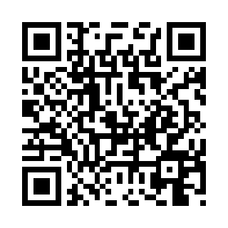
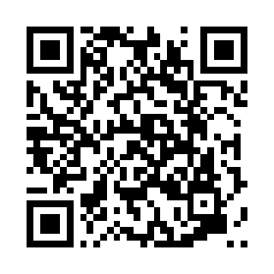
Short Video & Interactive Links
Click the buttons or scan the QR codes during class.
1. Observe chemical change
Baking soda + vinegar demonstration
2. Balance equations
Khan Academy worked examples
Open link ▶
Open link ▶
3. Word/symbol equations
Cognito short explanation
4. Interactive practice
PhET Balancing Chemical Equations
Open link ▶
Open link ▶
Tip: If YouTube is blocked, use the live experiment and the PhET simulation as alternatives.
21
Notes:
Use this slide for optional videos and interactive practice. Links and QR codes are clickable/scannable.

